Slide 1
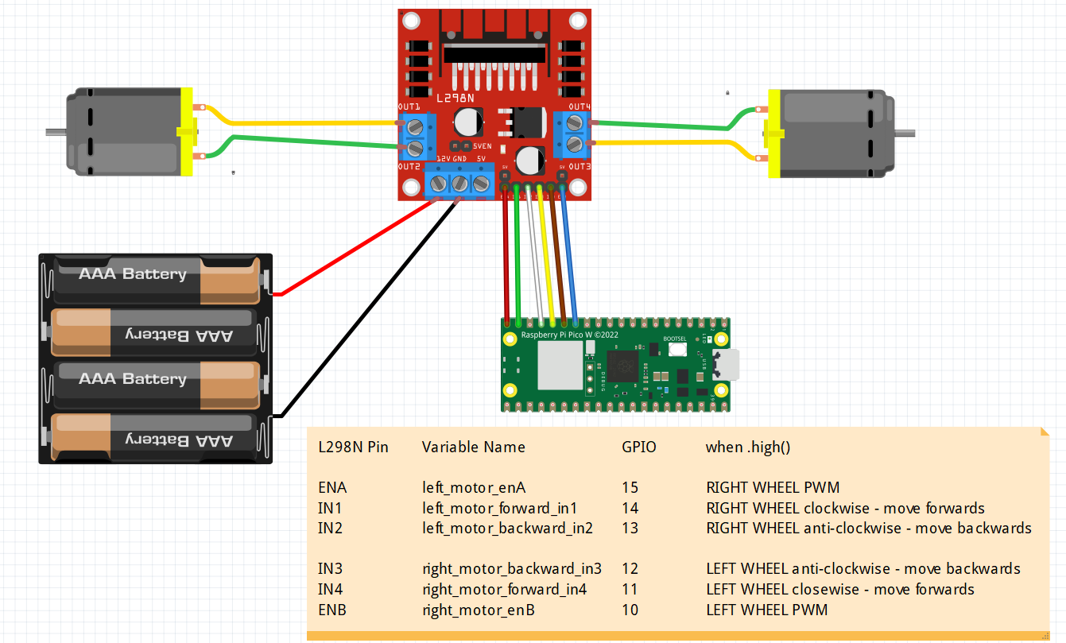
PINS ON THE LN298
ENA
Left wheel Throttle
Left Motor Forward
Right Motor Forward
ENB
Right wheel Throttle
Left Motor Backward
Right Motor Backward
on
LEFT
RIGHT

Slide 2
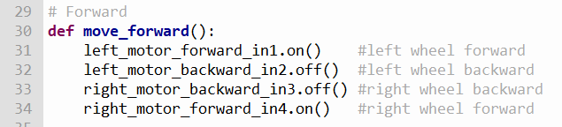
PINS ON THE LN298
ON-Move Forward
on
LEFT
RIGHT

Slide 3
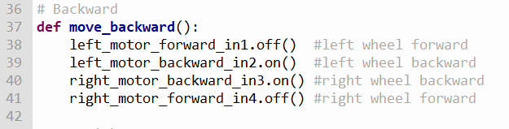
ON-Move Backward
LEFT
RIGHT

Slide 4
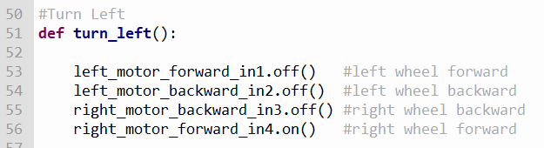
PINS ON THE LN298
TURN LEFT
on
LEFT
RIGHT

Slide 5
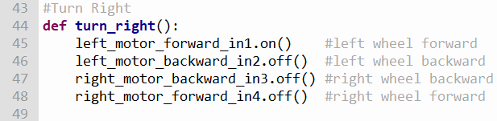
PINS ON THE LN298
TURN RIGHT
on
LEFT
RIGHT

Slide 6
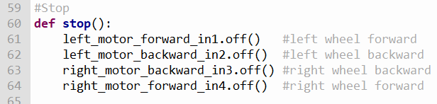
PINS ON THE LN298
STOP
on
LEFT
RIGHT

Slide 7
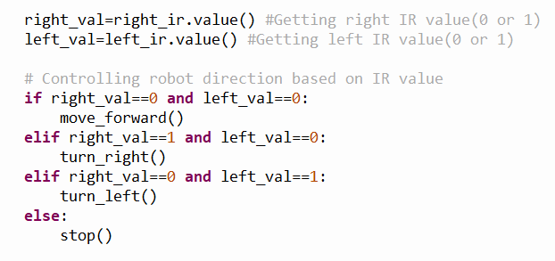
HOW THE IR SENSOR WORKS
1
1
0
0
1
1
0
0
ROBOT
VEERS LEFT
ROBOT
VEERS RIGHT
ROBOT
STOPS
ROBOT
ON COURSE
CORRECTION
MOVE RIGHT
CORRECTION
MOVE LEFT

Slide 8
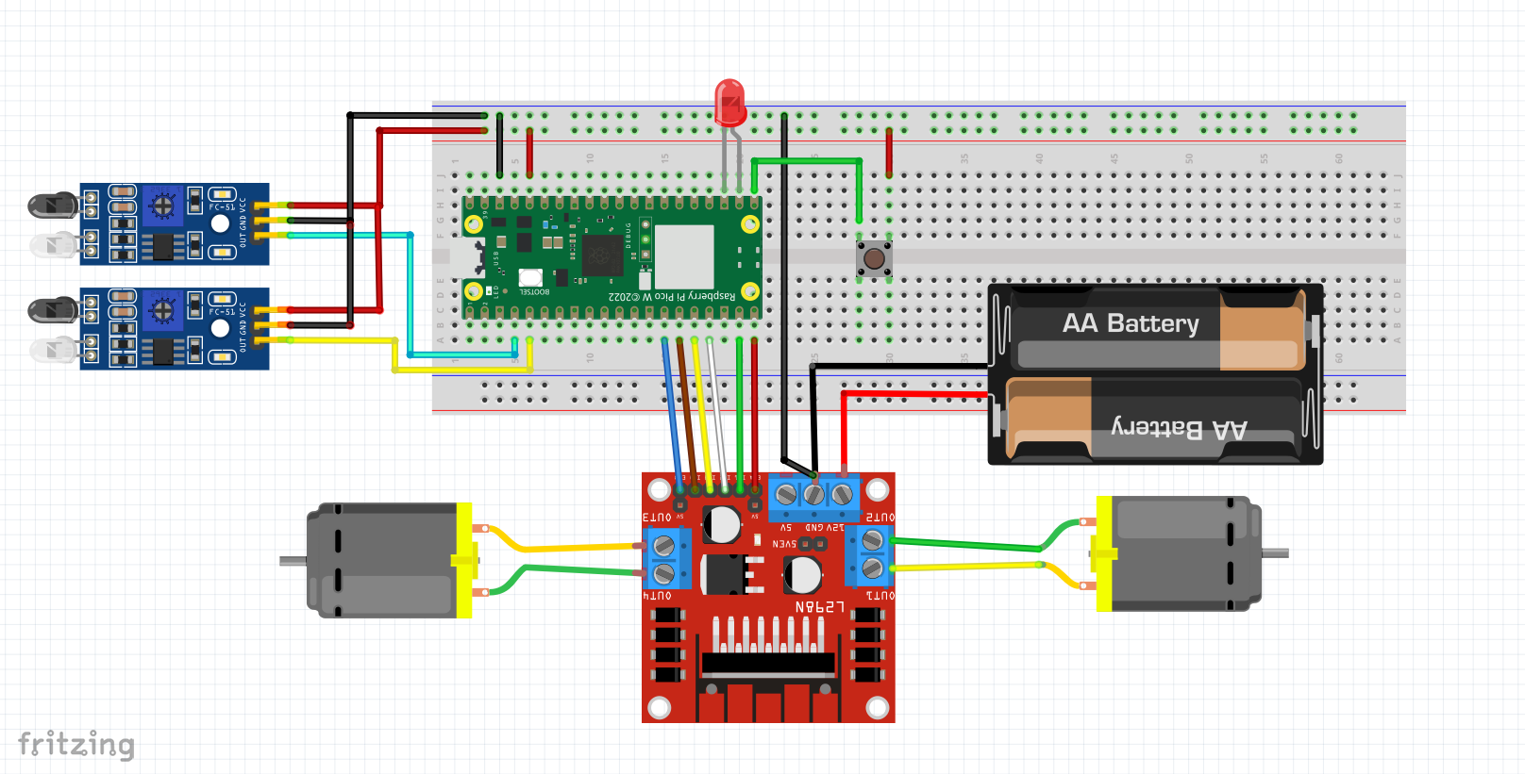
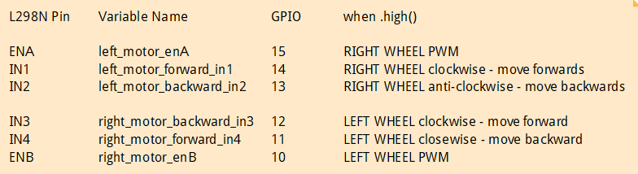
GPIO17
GPIO16
GPIO2
GPIO 3

Slide 9
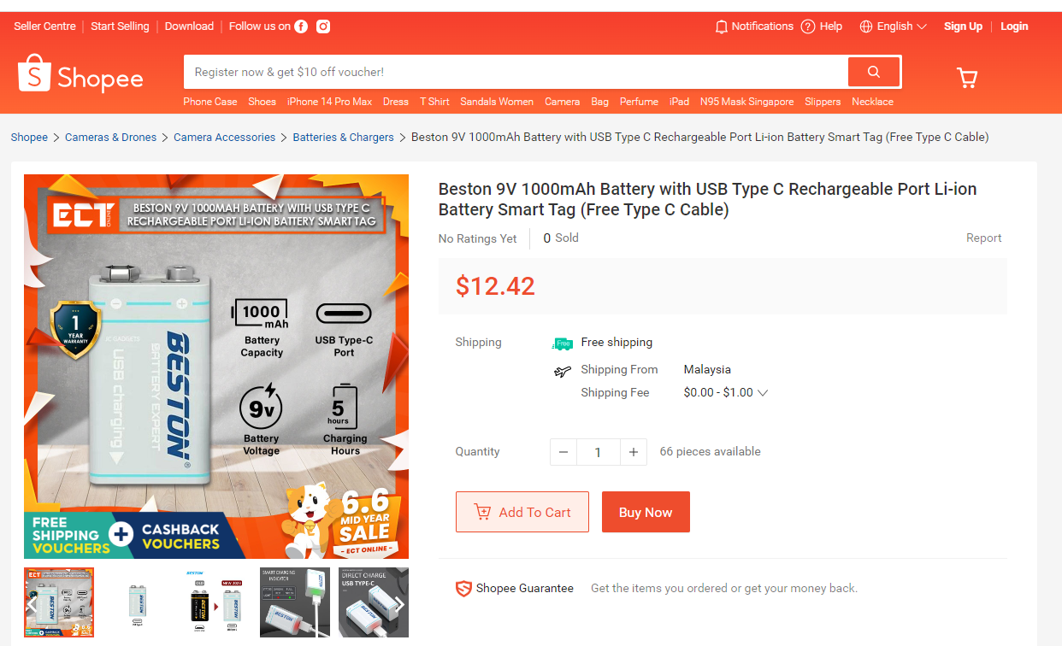
https://shopee.sg/Beston-9V-1000mAh-Battery-with-USB-Type-C-Rechargeable-Port-Li-ion-Battery-Smart-Tag-(Free-Type-C-Cable)-i.203611580.22138888328

Slide 10
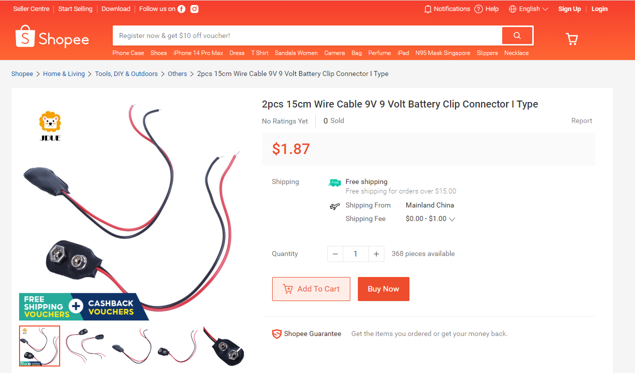
https://shopee.sg/2pcs-15cm-Wire-Cable-9V-9-Volt-Battery-Clip-Connector-I-Type-i.115725173.20779261825?sp_atk=ca99f17f-20a4-4b7d-8a91-010635a30d0f&xptdk=ca99f17f-20a4-4b7d-8a91-010635a30d0f

Slide 11
The Robot Class - classRobotCar.py
Getting ChatGPT to explain what a class is
Example of a python program using class
Controlling the Robot via Wifi – robby_wifi_controlled.py
How to get ChatGPT to generate the html page
Sample:
give me a html page using bootstrap. 1 FORWARD button in green 1 BACKWARD button in green, 1 LEFT button in blue, 1 RIGHT button in blue and 1 STOP button in red in the middle of these 4 buttons. Add a caption on top of these button : WEB CONTROLLED ROBOT CAR. All buttons belongs to the same group ‘key’ to submit to a pico web server. Do not use javascript

